Slide 1


Umbrella Opportunities
And How to Manage Them

Slide 2
Situation
Orasi comes to agreement with a customer to provide professional services.
The agreement provides approval for a certain amount of budget.
This budget money may be used to fund multiple projects.
Projects and roles may include more than one Orasi line of business.

Slide 3
Objectives
Pay proper commission to the sales group
Have each child project setup in Bluesource, so consultants can enter time against their particular project
Track burndown against the umbrella allocation
Track burndown against each project
Provide the proper mechanism to trigger accurate invoicing

Slide 4
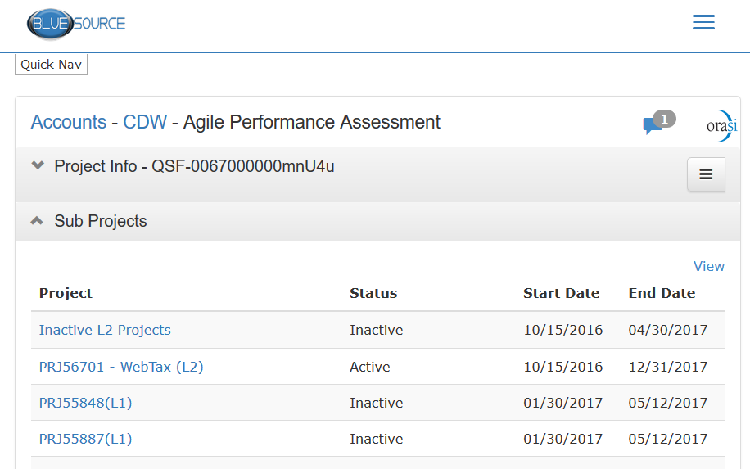
Bluesource Setup
Umbrella Project
Sub-projects

Slide 5
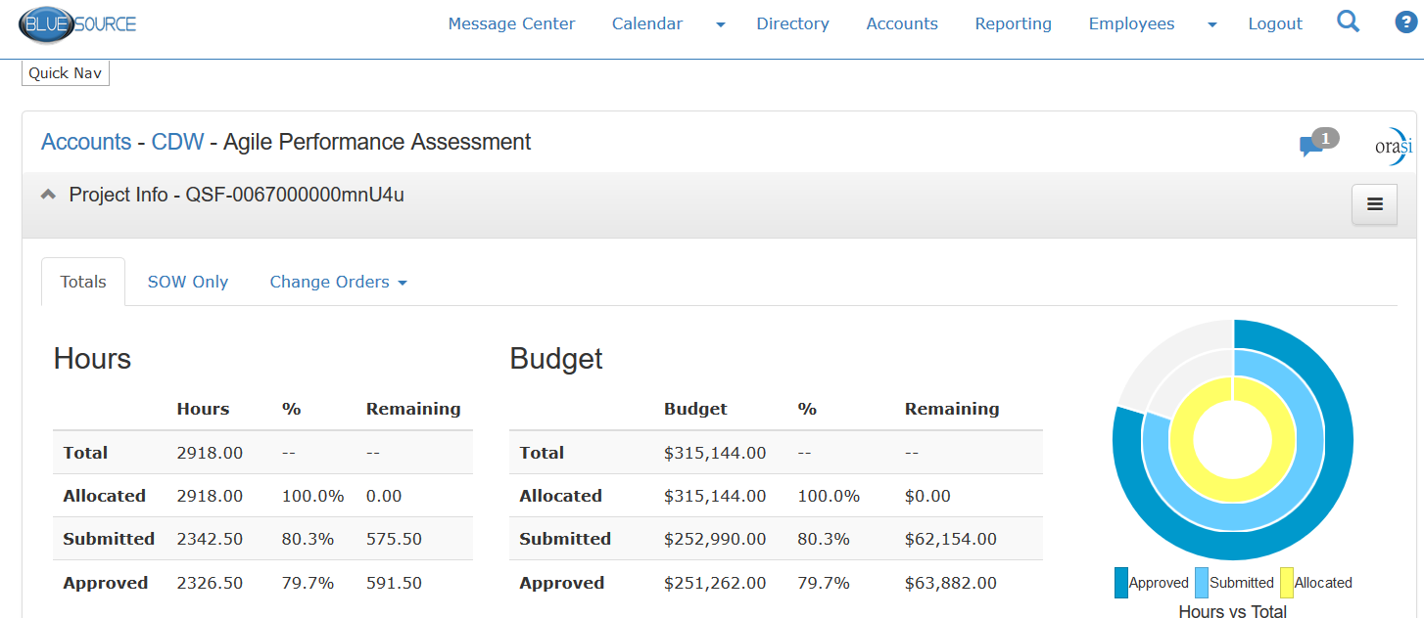
Umbrella Reporting in Bluesource

Slide 6
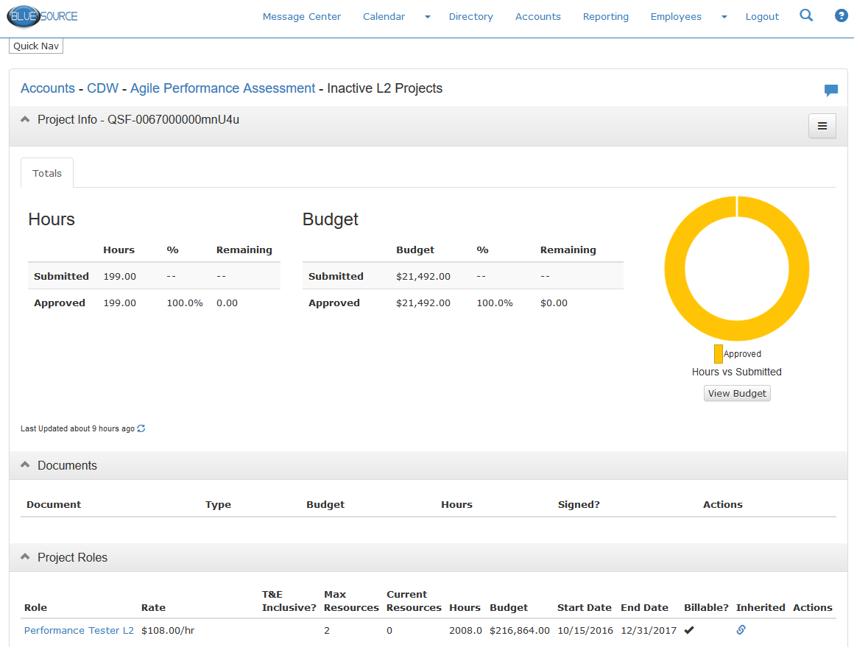
Drilldown to Bluesource Sub-project Reporting

Slide 7
Salesforce Setup
Opportunity for Umbrella Project
$0 Revenue
Submitted to Service Order to get the umbrella project setup in Salesforce
Notes in the Salesforce opportunity indicating this is an umbrella project with an approved budget of $x.xx amount.
No commission up-front
Opportunities for Sub-projects
Via Change Order
retains umbrella project QSF#
Allows easy understanding of the umbrella\sub-project relationship
Allows for setup of sub-project under umbrella in Bluesource
A Change Order is required to generate a sub-project
Native inclusion in the Composite Burn Down report
Commission paid as each project has money committed

Slide 8
Workflow
Setup
Umbrella Opportunity
Service opportunity sent to Service Order as $0
Note indicating funding cap
Sub-projects
A Salesforce Change Order is sent to Service Order
Roles, rates, hours are setup
Closure
Umbrella Opportunity
Closed when funding is fully consumed
Sub-projects
Closed as each is completed

